Slide 1


Document Intelligence in Azure Portal
Project Document Intelligence is a powerful feature in Azure Portal that simplifies document analysis and extraction of key information. It leverages machine learning and AI to automate the process, saving time and effort.

Slide 2

Understanding Document Intelligence
1
Automated Insights
2
Enhanced Efficiency
Project Document Intelligence automatically extracts key data and insights from project documents, such as contracts, proposals, and reports.
It eliminates the need for manual data entry and analysis, freeing up time for more strategic tasks.
3
Data-Driven Decisions
4
Improved Accuracy
The extracted insights provide valuable data for informed decision-making and project management.
Project Document Intelligence leverages advanced machine learning models to ensure high accuracy in data extraction.

Slide 3



Key Features of Document Intelligence
Document Processing
Data Extraction
Customizable Models
Processes various document formats, including PDFs, Word files, and spreadsheets.
Extracts key information like dates, amounts, and names.
Allows for training custom models for specific document types.
Identifies and classifies different document types.
Ensures accurate data extraction for unique industry needs.
Handles large volumes of documents efficiently.

Slide 4




Accessing Document Intelligence in Azure Portal
Login to Azure Portal
Navigate to Cognitive Services
Create a Document Intelligence Resource
Access the Azure Portal using your account credentials.
Find the Cognitive Services section in the Azure Portal.
Select Project Document Intelligence and create a new resource.

Slide 5
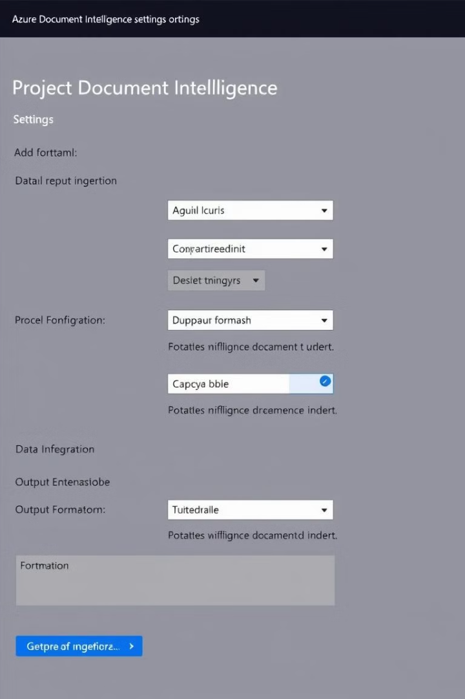
Configuring Document Intelligence Settings
Model Training
Data Ingestion
Train custom models for specific document types and data extraction needs.
Configure the process for uploading and managing project documents.
Output Formats
Security Settings
Choose the desired output format for extracted data, such as CSV, JSON, or XML.
Configure access control and security measures to protect sensitive project information.

Slide 6
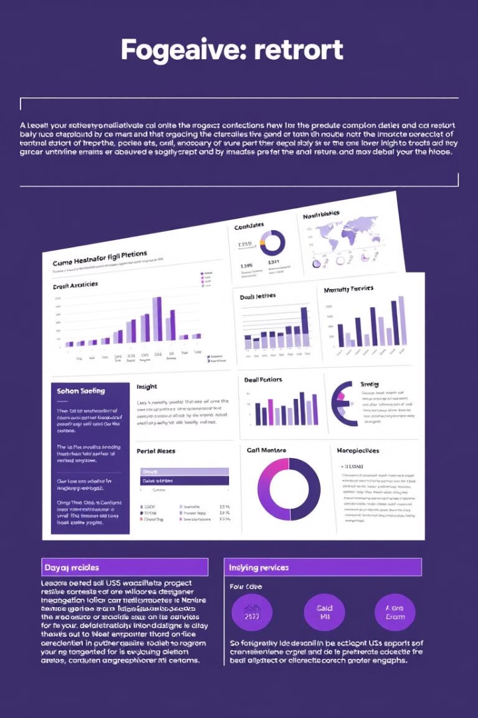
Analyzing Project Documents with Document Intelligence
1
Upload Documents
Upload project documents to the Project Document Intelligence service.
2
Apply Models
Choose the appropriate model based on the document type.
3
Extract Insights
Project Document Intelligence analyzes documents and extracts key information.
4
Review Results
Review the extracted insights and validate the accuracy of the analysis.

Slide 7

Use Cases and Examples
Document Intelligence has a wide range of applications across diverse industries, empowering businesses to optimize their workflows and gain valuable insights.
Industry
Use Case
Healthcare
Extract patient information from medical records, automate claims processing, and improve clinical decision-making.
Finance
Automate invoice processing, extract financial data from reports, and enhance fraud detection.
Legal
Process legal documents, extract key clauses, and automate contract review.
Retail
Analyze customer feedback, automate order processing, and optimize inventory management.
Human Resources
Automate resume screening, extract employee data from forms, and streamline onboarding processes.

Slide 8

Conclusion and Next Steps
Project Document Intelligence is a transformative solution for project management, enhancing efficiency, accuracy, and insights.
Integrate this powerful tool into your project workflows to streamline document analysis, gain valuable insights, and make data-driven decisions.

Slide 9


